Slide 1
OBJECT ORIENTED PROGRAMMING
ABDUL RAHEEM RIHAM AHAMED
HND COMPUTING IDM

Slide 2
Contents
Why oop?
Oop concept
What is objects?
Real world object
What is class?
Object and class
The pillars of OOP
Characteristics of OOD
Oop relationship
Cardinality relationship
Dependency
Association
Aggregation
Composition
Inheritance
Reference

Slide 3

WHY OOP?
OOPs are closely related to the real-world entities
Objects can be used effectively to represent real-world entities

Slide 4
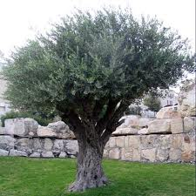



OOP Concept
Complexity
Interaction
Real world
Computer

Slide 5







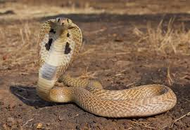


WHAT IS objects?
Objects are real-world entities with states and behaviors
Notes:
Objects are basic building blocks for program design.
An object is a collection of data members and associated member functions.
An object can represent a person, a place, or a data table.
Each object is identified by a unique name. Each object must be a member of a particular class.
Example: chair, table, blackboard are the objects of the class (class).

Slide 6
Real world object
State - Descriptive characteristics
Behaviors - What it can do (or What can be done to it)
Colour
Model
Price
Cylinder Capacity
Driven
Stopped
Turned
Reversed

Slide 7
What is Class?
All objects may be categorized in an abstract way according to their common characteristics (states / attributes) and behaviors (operations).
A class describes all objects of a particular kind in an abstract way.
Notes:
Objects can be created using a class of user-defined data types.
A class is a collection of objects with identical properties, common behavior, and shared relationships.
Once the class is defined, any number of objects of that class is created.
Classes are user-defined data types. A class can contain both data and functions.
For example, the planets, the sun, and the moon are members of the solar system class.

Slide 8
Object and class
Class
Object
A description of the common properties of a set of objects.
A representation of the properties of a single instance.

Slide 9

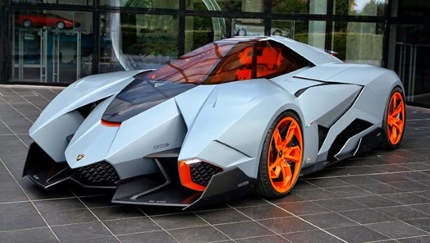

Example – Modeling a traffic simulation
One entity to deal with is a car.
What is the colour of a car?
How fast a car can be driven?
Where it is right now?
A car
You will need a specific car to answer these questions. Why? – A car can refer to any car. It refers to a car class.

Slide 10


Consider a car that refers to my old car.
What is the colour of the car? - Black
How fast it can be driven? – 20 kmph
Where it is right now? – Parked on logs in my home garage
My old car
We refer to a particular object as an instance of a car

Slide 11
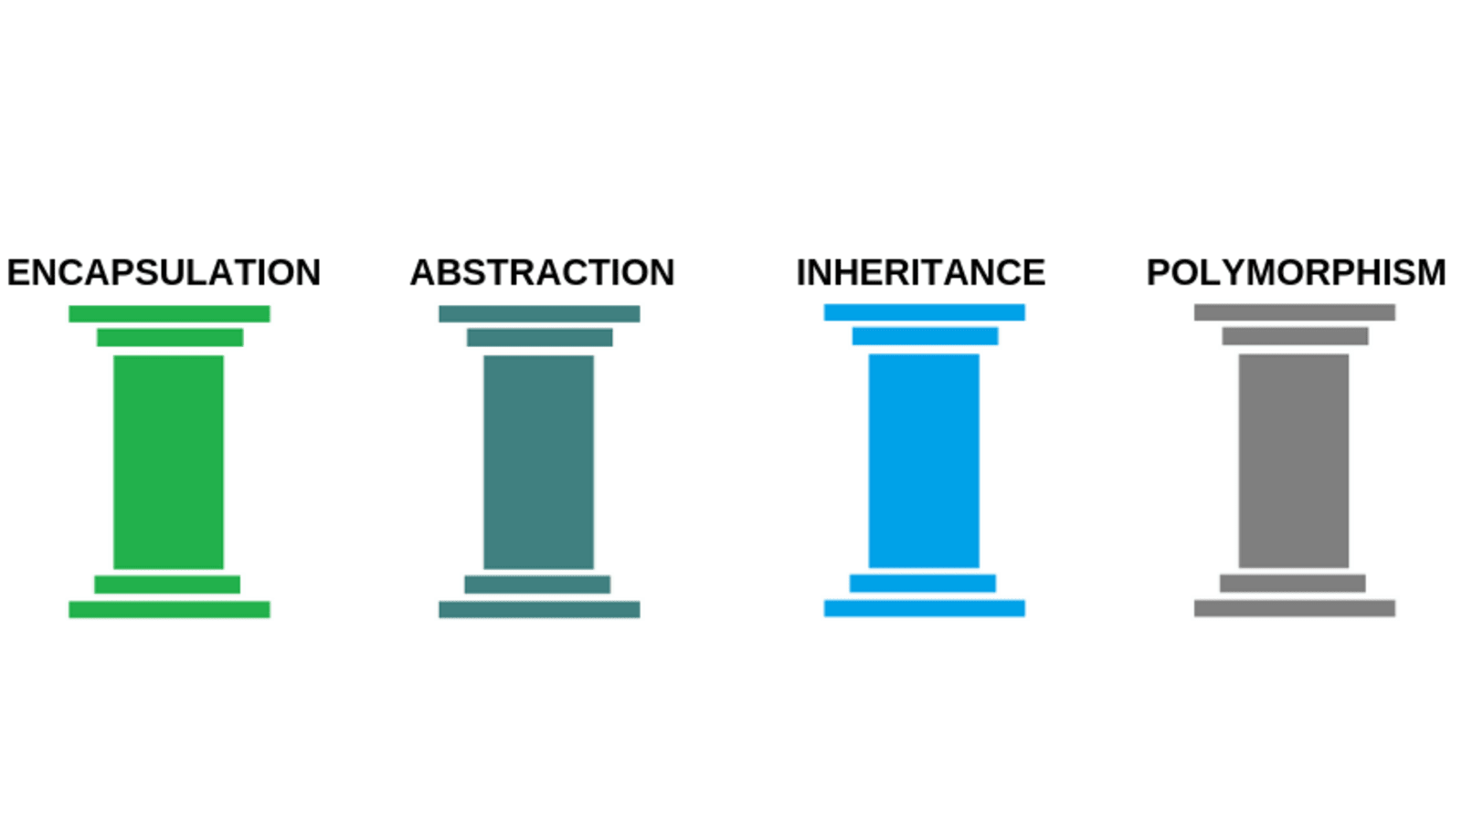
The pillars of OOP
Notes:
Abstraction – The act of representing essential features without including the background details.
Encapsulation – The wrapping up of data and methods into a single unit (class) is known as encapsulation.
Inheritance – Inheritance is the process by which objects of one class acquire the properties of another class.
Polymorphism – Polymorphism is the ability of an object to exist in many forms.

Slide 12
Characteristics of OOD
Objects are abstractions of real-world or system entities.
Objects are independent and encapsulate state and representation information
Object may be distributed
Objects may execute sequentially or in parallel.

Slide 13
Class Notation
Book
name: String
author: String
price: double
+ getName() :String
+ getPrice() : double
+ getQtyInStock() : int
Class name
Data Declarations
Method Declarations
- ⇒ Private
+ ⇒ Public
# ⇒ Protected

Slide 14
OOP RELATIONSHIP
Cardinality Notation
Dependency
Association
Aggregation
Composition
Inheritance

Slide 15
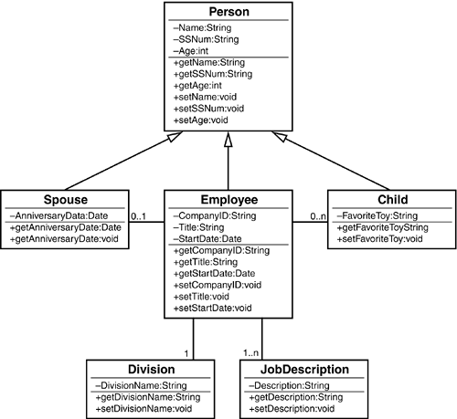
Cardinality Notation
The notation of 0 1 means that an example employee can have either zero or one spouse. The notation of 0 n means that an employee can have any number of children from zero to an unlimited number. The n basically represents infinity.
Notes:
Cardinality notation is relationship level in entities.

Slide 16
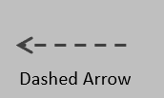
Dependency
class Move {
public void Roll() { ... }
}
class Player {
public void PerformAction(Move move) {
move.Roll();
}
}
Notes:
It is a relationship when objects of one class interact briefly with objects of another class. Normally, multiple makes no sense in a dependency.

Slide 17
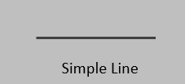
Association
public static void main (String[] args) {
Doctor doctorObj = new Doctor("Rick");
Patient patientObj = new Patient("Morty");
System.out.println(patientObj.getPatientName() +
" is a patient of " + doctorObj.getDoctorName());
}
Notes:
This relationship arises when the objects of one class know the objects of another class. The relationship can be one-to-one, one-to-many, many-to-one, or many-to-many. Also, objects can be created or deleted independently.

Slide 18
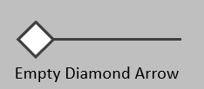
Aggregation
class Address{
//code here
}
class StudentClass{
private Address studentAddress;
//code here
}
Notes:
It is a "has-a" relationship and is a one-way form of association. This relationship exists when a class owns but shares a reference to objects from another class.

Slide 19
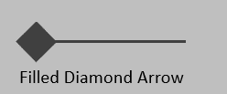
Composition
class Room {
//code here
}
class House {
private Room room;
//code here
}
Notes:
It's a "part of" type of relationship and it's a strong type of association. In other words, composition occurs when one class owns and contains objects of another class.

Slide 20
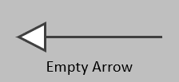
Inheritance
abstract class Vehicle {
//code here
}
class Car extends Vehicle {
//code here
}
Notes:
He is a relative. It is a mechanism by which a class can acquire the properties and behavior of an existing class (sometimes more classes, if the language allows multiple inheritances).

Slide 21
Reference
DEV Community. 2021. Common types of OOP relationships and their UML representation. [online] Available at: https://dev.to/tommyc/common-types-of-oop-relationships-and-their-uml-representation-5b27 [Accessed 18 November 2021].
Tutorials Link. 2021. Basic Characteristics of Oops. [online] Available at: https://tutorialslink.com/Articles/Basic-Characteristics-of-Oops/1308 [Accessed 18 November 2021].

Slide 22
THANK YOU

